Slide 1
Introduction
Reading input data, processing it and displaying the results are the three tasks of any program.
There are two ways to accept the data.
In one method, a data value is assigned to the variable with an assignment statement.
Another way of accepting the data is with functions.

Slide 2
Formatted function
With the formatted functions, the input or output is formatted as per our requirement.
All the I/O function are defined as stdio.h header file.
Header file should be included in the program at the beginning.

Slide 3
Input and Output Functions
Formatted Functions
Unformatted Functions
printf()
scanf()
getch() putch()
getche() putchar() getchar() puts()
gets()

Slide 4
Formatted Functions
It read and write all types of data values.
Require format string to produce formatted result
Returns value after execution
Binary data is converted to ASCII before being stored, manipulated or output
Uses more space and it is computationally expensive because of the conversions
Unformatted Functions
Works only with character data type
Do not require format conversion for formatting data type
Transfers data in its raw form or binary representation without any conversions
simple, efficient and compact

Slide 5
printf( ) function
This function displays output with specified format
It requires format conversion symbol or format string and variables names to the print the data
The list of variables are specified in the printf() statement
The values of the variables are printed as the sequence mentioned in printf()
The format string symbol and variable name should be the same in number and type

Slide 6
printf( ) function
Syntax
printf(“control string”, varialbe1, variable2,..., variableN);
The control string specifies the field format such as %d, %s, %g, %f and variables as taken by the programmer

Slide 7
void main()
{
int NumInt = 2;
float NumFloat=2.2;
char LetterCh = ‘C’;
printf(“%d %f %c”, NumInt, NumFloat, LetterCh);
}
Output :
2 2.2000 C

Slide 8
void main()
{
int NumInt = 65;
clrscr();
printf(“%c %d”, NumInt, NumInt);
}
Output :
A 65

Slide 9
scanf() function
scanf() function reads all the types of data values.
It is used for runtime assignment of variables.
The scanf() statement also requires conversion symbol to identify the data to be read during the execution of the program.
The scanf() stops functioning when some input entered does not match format string.

Slide 10
scanf() function
Syntax :
scanf(“%d %f %c”, &a, &b, &c);
Scanf statement requires ‘&’ operator called address operator
The address operator prints the memory location of the variable
scanf() statement the role of ‘&’ operator is to indicate the memory location of the variable, so that the value read would be placed at that location.

Slide 11
scanf() function
The scanf() function statement also return values. The return value is exactly equal to the number of values correctly read.
If the read value is convertible to the given format, conversion is made.

Slide 12
void main()
{
int a;
clrscr();
printf(“Enter value of ‘A’ : “);
scanf(“%c”, &a);
printf(“A : %c”,a);
}
OUTPUT
Enter value of ‘A’ : 8
A : 8

Slide 13
void main()
{
char a;
clrscr();
printf(“Enter value of ‘A’ : “);
scanf(“%d”, &a);
printf(“A : %d”,a);
}
OUTPUT
Enter value of ‘A’ : 255
A : 255
Enter value of ‘A’ : 256
A : 256

Slide 14
Data Type |  | Format string
Integer | Short Integer | %d or %i
 | Short unsigned | %u
 | Long signed | %ld
 | Long unsigned | %lu
 | Unsigned hexadecimal | %u
 | Unsigned octal | %o
Real | Floating | %f or %g
 | Double Floating | %lf
Character | Signed Character | %c
 | Unsigned Character | %c
 | String | %s
Octal number |  | %o
Displays Hexa decimal number in lowercase |  | %hx
Displays Hexa decimal number in lowercase |  | %p
Aborts program with error |  | %n

Slide 15
void main()
{
int a = 1, b = a + 1, c = b + 1, d = c + 1;
clrscr();
printf(“\t A = %d\nB = %d \’C = %d\’”,a,b,c);
printf(“\n\b***\D = %d**”,d);
printf(“\n*************”);
printf(“\rA = %d B = %d”, a, b);
}
OUTPUT
A = 1
B = 2 ‘C = 3’
***D=4**
A = 1 B = 2******

Slide 16
Unformatted Functions
C has three types of I/O functions
  Character I/O
  String I/O
  File I/O
  Character I/O

Slide 17
getchar ( )
getchar() function will read a single character from the standard input.
The return value of getchar() is the first character in the standard input.
The input is read until the Enter key is pressed, but only the first character in the input will be returned
The input entered is displayed in the screen
Syntax
  VariableName = getchar();
Example
  char c;
  c = getchar();

Slide 18
putchar( )
putchar() function will print a single character on standard output.
The character to be printed is passed to putchar() function as an argument.
The return value of putchar() is the character which was written to the output..
Syntax
  putchar (variableName);
Example
  char c = ‘C’; putchar(c);

Slide 19
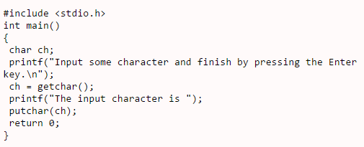
EXAMPLE:
getchar() and putchar() functions are part of the standard C library header stdio.h

Slide 20
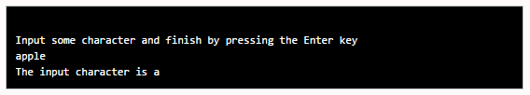
Output:

Slide 21
getch() and getche()
These functions are similar to getchar() and putchar(), but they come from the library header conio.h
These functions read any alphanumeric character from the standard input device.
The character entered is not displayed by the getch() function.
The character entered is displayed by the getche() function.
Exampe
  ch = getch();
  ch = getche();

Slide 22
putch()
putch() is used to display the character

Slide 23
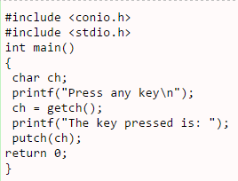

Example:
Output:

Slide 24
gets()
This function is used for accepting any string through stdin keyword until enter key is pressed.
The header file stdio.h is needed for implementing the above function.
Syntax
  char str[length of string in number];
  gets(str);
void main()
{
char ch[30];
clrscr();
printf(“Enter the string : “);
gets();
printf(“\n Entered string : %s”, ch);
}

Slide 25
puts()
This function prints the string or character array.
It is opposite to gets()
char str[length of string in number];
gets(str);
puts(str);

